Slide 1
Let’s build a costco
Capstone Project by Jeremy McCormick
NSS DA9 Cohort

Slide 2
Objectives
About the project
Motivation
Analysis
Conclusion and Recommendations

Slide 3
Data Question(s)
Out of the states that don’t have Costco’s what would be the best city to open up a new Costco using member demographic?
Analyze 2 soon to open locations and find if they’re are valuable insights to be gained?

Slide 4
Why Costco?
Current and soon to be former employee
Started out at an established warehouse then moved to a state where there is one Costco
Loves growth and expansion

Slide 5
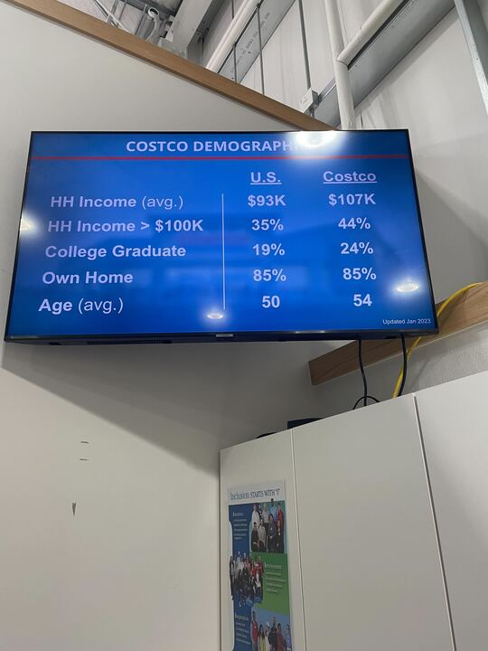
The project
Census data and Costco demographic data being used
Project done primarily in excel and Tableau

